Slide 1
Graph Representation Learning with Deep Embedding Approach
Hanjun Dai
Ph.D. student in School of Computational Science & Engineering
Georgia Institute of Technology

Slide 2
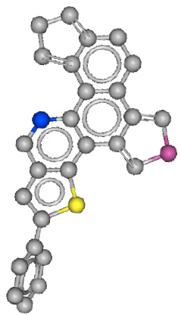
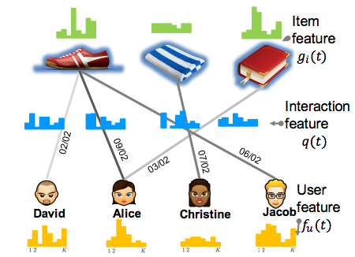
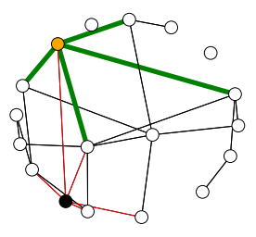
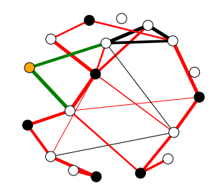
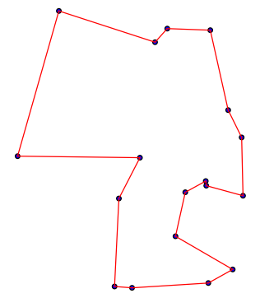
Graph applications
Recommendation
Drug discovery
Dai et.al, structure2vec, ICML 2016
Dai et.al, DeepCoevolve, Recsys DLRS 2016
Vertex Cover
Maxcut
TSP
Knowledge Graph
Trivedi et.al, Know-Evolve, ICML 2017
Dai et.al, VRN, in submission
Dai et.al, S2V-DQN, NIPS 2017

Slide 3
Outline
Review of traditional approaches
Our architecture
Experiments on RNA and molecules
Extension to social network and recommendation
Application in graph combinatorial optimization

Slide 4
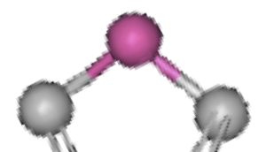
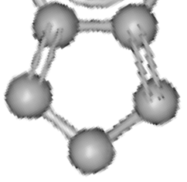
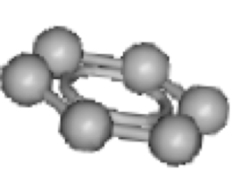
Review: RNA / Molecule property prediction
Application: High throughput virtual screening
Structured data
Target
Handcrafted feature
Binding affinity:
Binary Classification Problem
S={
U
C
U
,
U
U
C
C
U
U
C
A
G
…… ,
G
}
C
A
0 | 2 | 0 | 0 | … | … | … | … | 0 | 2
AA
AC
AU
AG
GU
GG
S={
Power Conversion Efficiency
(PCE): Regression problem
,
…… ,
}

Slide 5
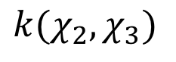
Review: RNA / Molecule property prediction
Problem with handcrafted features
Stage 1: Build kernel Matrix
Stage 2: Train classifier on top
$$k(χ_{2}, χ_{3})$$
Or High-dim Explicit Bag-of-words Feature Map
0 | 2 | 0 | 0 | … | … | … | … | 0 | 2
AA
AC
AU
AG
GU
GG
Constructed features are
not aware of task
Not scalable for millions of data

Slide 6







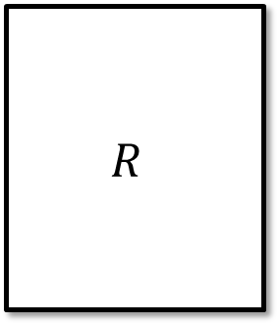

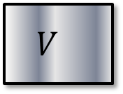
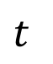
Review: Temporal Recommendation
Matrix factorization
Shoe
Towel
Book
item
$$R$$
$U$
$$V$$
07/02
≈
11/02
user
02/02
09/02
06/02
03/02
David
Alice
Christine
Jacob
Epoch division
who will do what and when?
$$t$$

Slide 7



Review: Graph Combinatorial Optimization
Minimum vertex/set cover
Advertisers: influence maximization
2 - approximation for minimum vertex cover
Repeat till all edges covered: Select uncovered edge with largest total degree
Manually
designed rule.
Can we learn
from data?
NP-hard problems

Slide 8
Outline
Review of traditional approaches
Our architecture
Experiments on RNA and molecules
Extension to social network and recommendation
Application in graph combinatorial optimization

Slide 9
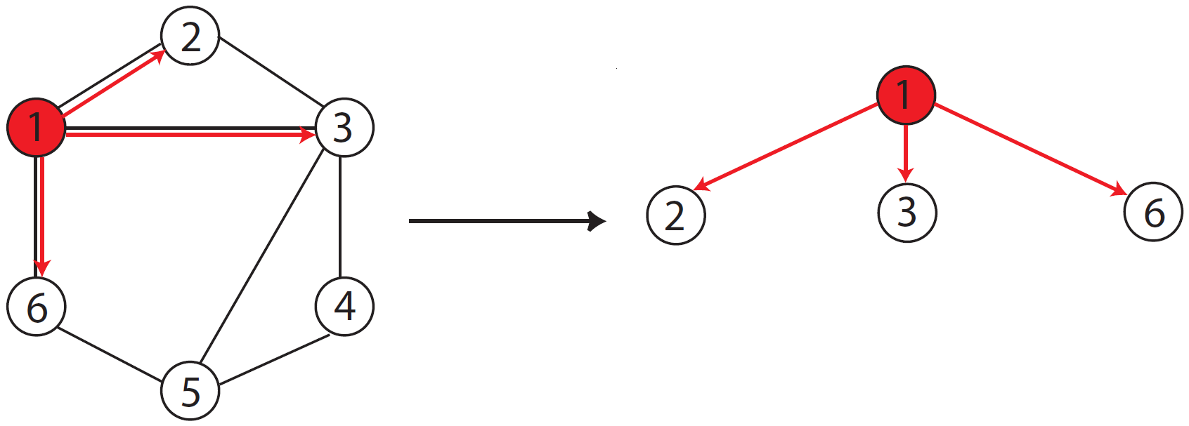
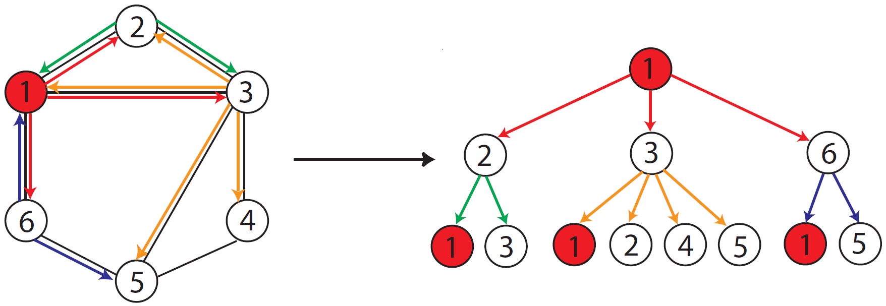



Designing a new architecture
(2,13)
WL graph isomorphism check
(1,236)
(3,1245)
(4,35)
(1,236)
(6,15)
……
(5,346)
[Shervashidze et al. 11]
((1,236), (2,13) (3,1245) (6,15))

Slide 10







Intuitive understanding: local filters
Image
Graph
Filter applies to each local patch:
Filter applies to each 1-hop neighborhood:

Slide 11
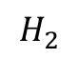
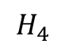
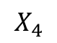
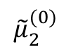
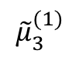
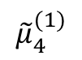
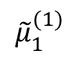
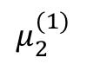
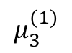
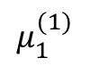
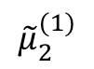
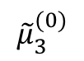
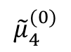
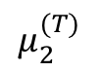
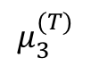
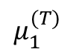
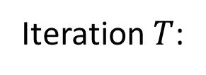
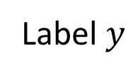
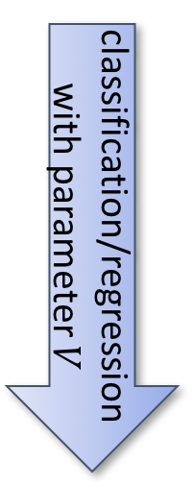
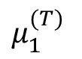
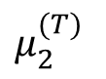
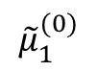
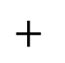
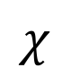
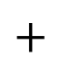
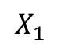
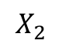
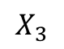
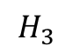
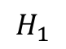
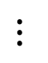
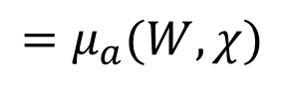
End to end learning
Iteration 1:
$$μ_{1}^{(1)}$$
$$μ_{2}^{(1)}$$
$$μ_{3}^{(1)}$$
……
$${\tilde{μ}}_{1}^{(1)}$$
$${\tilde{μ}}_{2}^{(1)}$$
$${\tilde{μ}}_{3}^{(1)}$$
$${\tilde{μ}}_{4}^{(1)}$$
……
Iteration $T$:
$$μ_{1}^{(T)}$$
$$μ_{2}^{(T)}$$
$$μ_{3}^{(T)}$$
……
$${\tilde{μ}}_{2}^{(0)}$$
$${\tilde{μ}}_{3}^{(0)}$$
$${\tilde{μ}}_{1}^{(0)}$$
$$H_{2}$$
$$H_{3}$$
classification/regression
with parameter $V$
Aggregate
P
$$X_{2}$$
C
$$H_{1}$$
$$X_{3}$$
$$H_{4}$$
$$μ_{1}^{(T)}$$
$${\tilde{μ}}_{4}^{(0)}$$
$$=μ_{a}(W,χ)$$
$$+$$
$$X_{1}$$
$$μ_{2}^{(T)}$$
C
$$X_{4}$$
N
$$+$$
Label $y$
$$χ$$
$$⋮$$

Slide 12
Outline
Review of traditional approaches
Our architecture
Experiments on RNA and molecules
Extension to social network and recommendation
Application in graph combinatorial optimization

Slide 13
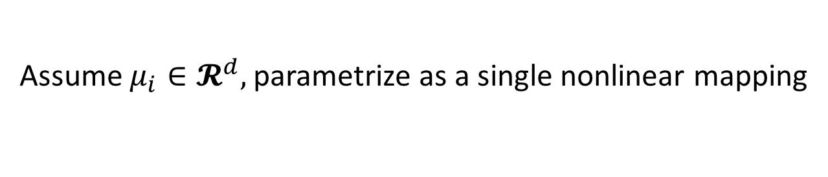
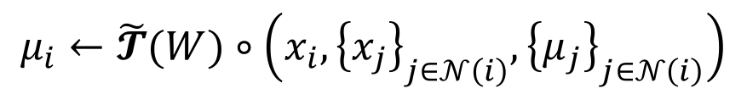
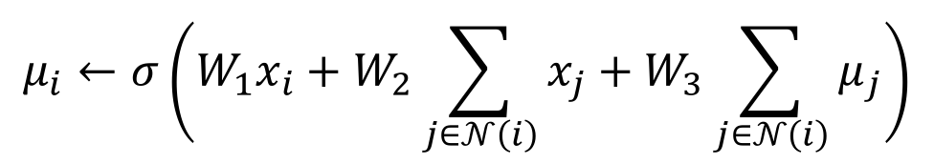
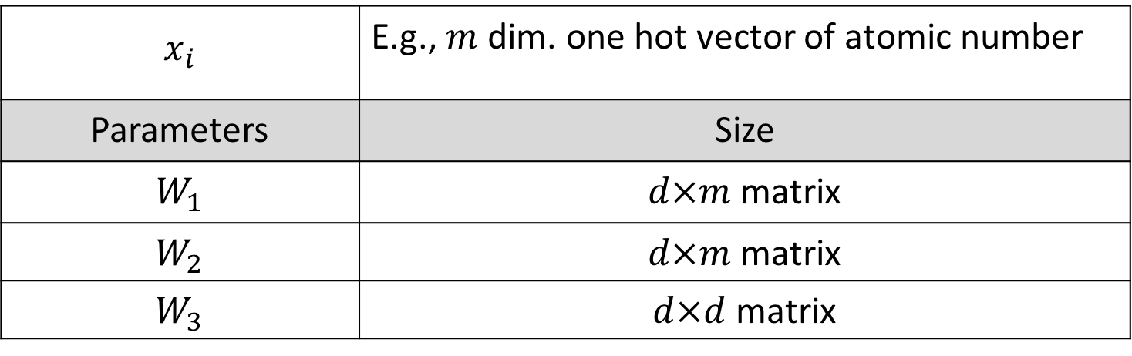

Parameterization
$$μ_{i}←\tilde{𝓣}(W)∘\left(x_{i},{\left\{x_{j}\right\}}_{j∈𝒩\left(i\right)},{\left\{μ_{j}\right\}}_{j∈𝒩\left(i\right)}\right)$$
Assume $μ_{i}∈𝓡^{d},$parametrize as a single nonlinear mapping
$$μ_{i}←σ\left(W_{1}x_{i}+W_{2}\sum_{j∈𝒩\left(i\right)}{x_{j}}+W_{3}\sum_{j∈𝒩\left(i\right)}{μ_{j}}\right)$$
$Max\left\{0,⋅\right\}$
$$x_{i}$$ | E.g., $m$ dim. one hot vector of atomic number
Parameters | Size
$$W_{1}$$ | $d×m$ matrix
$$W_{2}$$ | $d×m$ matrix
$$W_{3}$$ | $d×d$ matrix
Learn with supervision

Slide 14
Experiment on RNA sequences
MAE
MITOMI 2.0
28 TFs
Regression problem
 | S2V | Cmp
RMSE | 0.035 | 0.039
PCC | 0.62 | 0.45
SCC | 0.29 | 0.26
MAE
Dai et.al, Bioinformatics 2017

Slide 15

Experiment on Molecules
Dataset | Harvard clean energy project
Size | 2.3 million
Avg node # | 28
Avg edge # | 33
 | Test MAE | Test RMSE | # parameters
Mean predictor | 1.986 | 2.406 | 1
WL level-3 | 0.143 | 0.204 | 1.6 m
WL level-6 | 0.096 | 0.137 | 1378 m
DE-MF | 0.091 | 0.125 | 0.1 m
DE-LBP | 0.085 | 0.117 | 0.1 m
Organic Solar Panel Materials
predict
Power Conversion Efficiency (PCE)
(0 -12 %)

Slide 16
Experiment on Molecules
MAE
0.280
Embedding
reduces model
size by 10,000x !
Hashed
WL Level 6
0.150
Embedded
MF
0.120
0.095
Weisfeiler-Lehman
Level 6
0.085
Embedded
BP
0.1M
1M
10M
100M
1000M
Parameter
number
[Dai, Dai & Song 2016]

Slide 17



Interpretable results
Sequence Motifs
Molecule fragments
Effective ( > 10 ) | Ineffective ( < 0.5 )

Slide 18
Outline
Review of traditional approaches
Our architecture
Experiments on RNA and molecules
Extension to social network and recommendation
Application in graph combinatorial optimization

Slide 19


Extension to network analysis
One loss term per node
$$ℒ =\sum_{v∈𝒱}{loss(y_{v}, y(μ_{v}))}$$

Slide 20
Experiment on network analysis
Document classification
in citation network
 | Citeseer | Cora | Pubmed
# nodes | 3,327 | 2,708 | 19,717
# edges | 4,732 | 5,429 | 44338
# classes | 6 | 7 | 3
Label Rate | 0.036 | 0.052 | 0.003
Features | 3,703 | 1,433 | 500

Slide 21
Experiment on network analysis
 | Blogcatalog | Wikipedia
# nodes | 10,312 | 4,777
# edges | 333,983 | 184,812
# classes | 39 | 40
task | Group membership | POS tag

Slide 22

































Dynamic Graphs for Recommendation
time
Interaction
time/context
Unroll the interaction
along timeline
The bipartite
interaction graph
The temporal
ordering of events
$$X_{6}$$
$$t_{3}$$
$$H_{8}$$
$$H_{9}$$
LVM
$$G=(𝒱,ℇ)$$
Represent
$$X_{5}$$
$$H_{6}$$
$$H_{7}$$
$$t_{2}$$
$$X_{4}$$
$$t_{1}$$
$$H_{4}$$
$$H_{5}$$
Mini-batch training
using truncated back
propagation through
time (BPTT)
$$t_{0}$$
$$H_{1}$$
$$H_{2}$$
$$H_{3}$$
user/item
raw features
$$X_{1}$$
$$X_{2}$$
$$X_{3}$$
[Dai, et al. 2016]
Notes:
If we unroll the interactions between users and items, we can get a dependency graph which looks like this. Here the dependency comes from the assumption that the user or item's latent representation will change over time, after each interaction event. We can then abstract it as a directed graph on the right hand side.
Different from the previous scenario, here we get a single gigantic graph. So we apply stochastic training with truncated backpropagation through time, which is commonly used in recurrent neural network.

Slide 23

Experiment on recommendation
Favors ’recurrent’ events: watching TV programs; discussion on Forums; visiting restaurants

Slide 24
Outline
Review of traditional approaches
Our architecture
Experiments on RNA and molecules
Extension to social network and recommendation
Application in graph combinatorial optimization

Slide 25
Learning graph opt: Motivation
Minimum vertex/set cover
Branch and Bound
Constructive Approximation
Exponential time complexity
Results too weak
Cannot learn from solved instances!

Slide 26
Learning graph opt: Motivation
Data from same / similar distribution
Social network: Barabási–Albert
Supervised learning?
No such supervision
Road network: fixed graph with
evolving edge weights
Reinforcement learning!
Learning by trial and error
Images taken from Wikipedia

Slide 27





Learning graph opt: RL background
Reward $R(t)$: score you earned at current step
State $S$: current screen
Action $i$: move your board left / right
Action value function $\hat{Q}(S, i)$:
your predicted future total rewards
Policy $π(s)$: How to choose your action
Greedy policy:
$$i^{∗}=argmax_{i} \hat{Q}(S, i)$$
[Minh, et al. Nature 2015]

Slide 28








Learning graph opt: RL on graphs
$$\min_{x_{i}∈\left\{0,1\right\}} \sum_{i∈𝓥}{x_{i}}$$
$$s.t. x_{i}+x_{j}≥1, ∀\left(i,j\right)∈𝓔$$
Reward: $r^{t}=−1$
State $S$:
current partial solution
Action value function $\hat{Q}(S, i)$:
Expected negative future loss
Greedy Policy $π(s)$:
Add best node
[Dai, et al. NIPS 2017]

Slide 29



Learning graph opt: action-value function
Parameterize Action value function $\hat{Q}(S, i)$ with structure2vec
Train with Deep Q-Learning (DQN)
Bellman optimality equation

Slide 30


Learning graph opt: quantitative comparison
A distribution of
scale free networks
Optimal approximated by
running CPLEX for 1 hour
approximation ratio $≈1$

Slide 31
Learning graph opt: quantitative comparison
Train on small graphs with
50-100 nodes
Generalize to not only graphs from same distribution
But also larger graphs
Approximation ratio < 1.007

Slide 32
Learning graph opt: time-solution tradeoff
Generate 200 Barabasi-Albert networks with 300 nodes
Let CPLEX produces 1st, 2nd, 3rd, 4th feasible solutions
CPLEX
1st
CPLEX
2nd
Embedding
produces algorithm
with good tradeoff !
2-approx
2-approx +
RNN
CPLEX
3rd
Embedded
MF
CPLEX
4th

Slide 33
Learning graph opt: real-world data
MemeTracker graph: 960 nodes and 5000 edges
Learning from sampled subgraphs
Methods | Approximation Ratio
Optimal | 1.00 ( 473 nodes)
S2V-DQN | 1.002 ( 474 nodes)
MVCApprox-Greedy | 1.222 (578 nodes)
MVCApprox | 1.408 (666 nodes)
http://snap.stanford.edu/netinf/#data

Slide 34

Learning graph opt: learned strategy
Learned a greedy algorithm which is different from known ones

Slide 35


Learning graph opt: other problems
Maximum cut
Traveling Salesman Problem
Set cover
Learn with
Bipartite graph
Solution found
optimal
Set cover image taken from Wikipedia

Slide 36
Thanks to my collaborators in this project
Advisor:
Collaborators (alpha-beta order)
Bo Dai
Bistra Dilkina
Elias Khalil
Le Song
Rakshit Trevidi
Yichen Wang
Yuyu Zhang

Slide 37
Q&A

